Slide 1


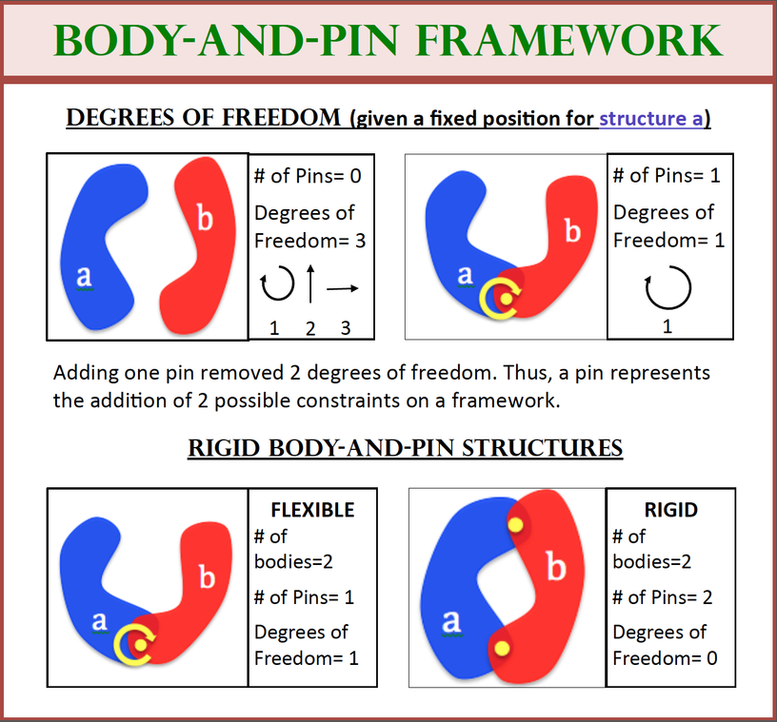
LEADER-FOLLOWER CONTROL USING DIRECTED GraphS Dana Fry ‘15 and Mina Khan ‘15 Faculty advisors: Audrey St. John and Jessica Sidman

